Slide 1
Agenda
Introduction to NLP
NLP Resources
NLP Applications
NLP Pipeline

Slide 2
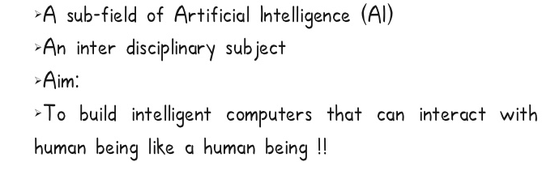
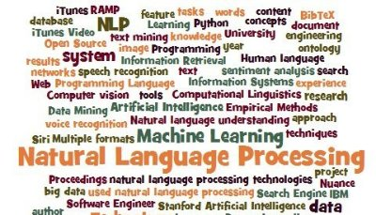
Introduction to NLP

Slide 3
Introduction to NLP…
Natural Language is communication way like English, Hindi etc.
Communication can be done through written mode (text) or spoken mode (Speech)
Text Processing OR Text Analytics OR Text Mining
Speech Recognition
Image Processing
Computer Vision
Generally NLP referred to Text processing though it’s more than that.
NLP is a sub-part of Artificial Intelligence so does ML, IoT, Data Science, or Big Data.

Slide 4
Introduction to NLP…
Other than processing text NLP means text generation called NLG.
NLP mostly work using computational Linguistics. Linguistics mostly computed through Machine Learning or other statistical techniques such as Tf-IDF.
As we human process language with the help of our knowledge that we gather since our childhood. Similarly most of NLP applications uses knowledge bases such as Wikipedia, dbpedia, ConceptNet etc which are manually crafted knowledge bases.

Slide 5
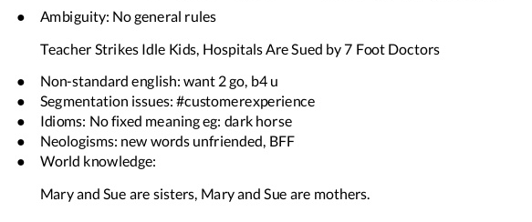
Challenges in NLP

Slide 6
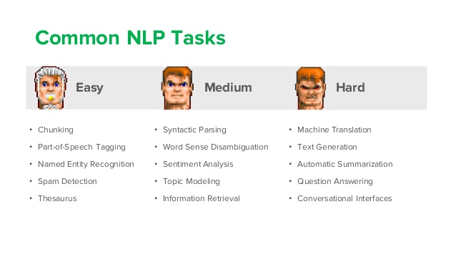
NLP Applications

Slide 7
NLP Applications
Text Mining or Text Analysis or Text Analytics or NLP
Information extraction(IE): This is concerned in general with the extraction of semantic information from text. This covers tasks such as named entity recognition, Coreference resolution, relationship extraction, etc.
Information retrieval(IR): This is concerned with storing, searching and retrieving information.
Text classification: This is concerned with storing, searching and retrieving information.
Machine translation: translate a document from one human language into another
Question answering: find answers to natural language questions in a text collection or database
Summarization: generate a short biography of X person from one or more news articles

Slide 8
Approaches
Regular Expressions Based:
Date/URL/Email/Room-number/Currency/Address/phone numbers, Tokenization
Rules Based:
POS Tagging/Sentence Segmentation
Modelling:
Classification, sentiment analysis
Knowledge Based:
Lemmatization/Concept Classification/Synonyms

Slide 9
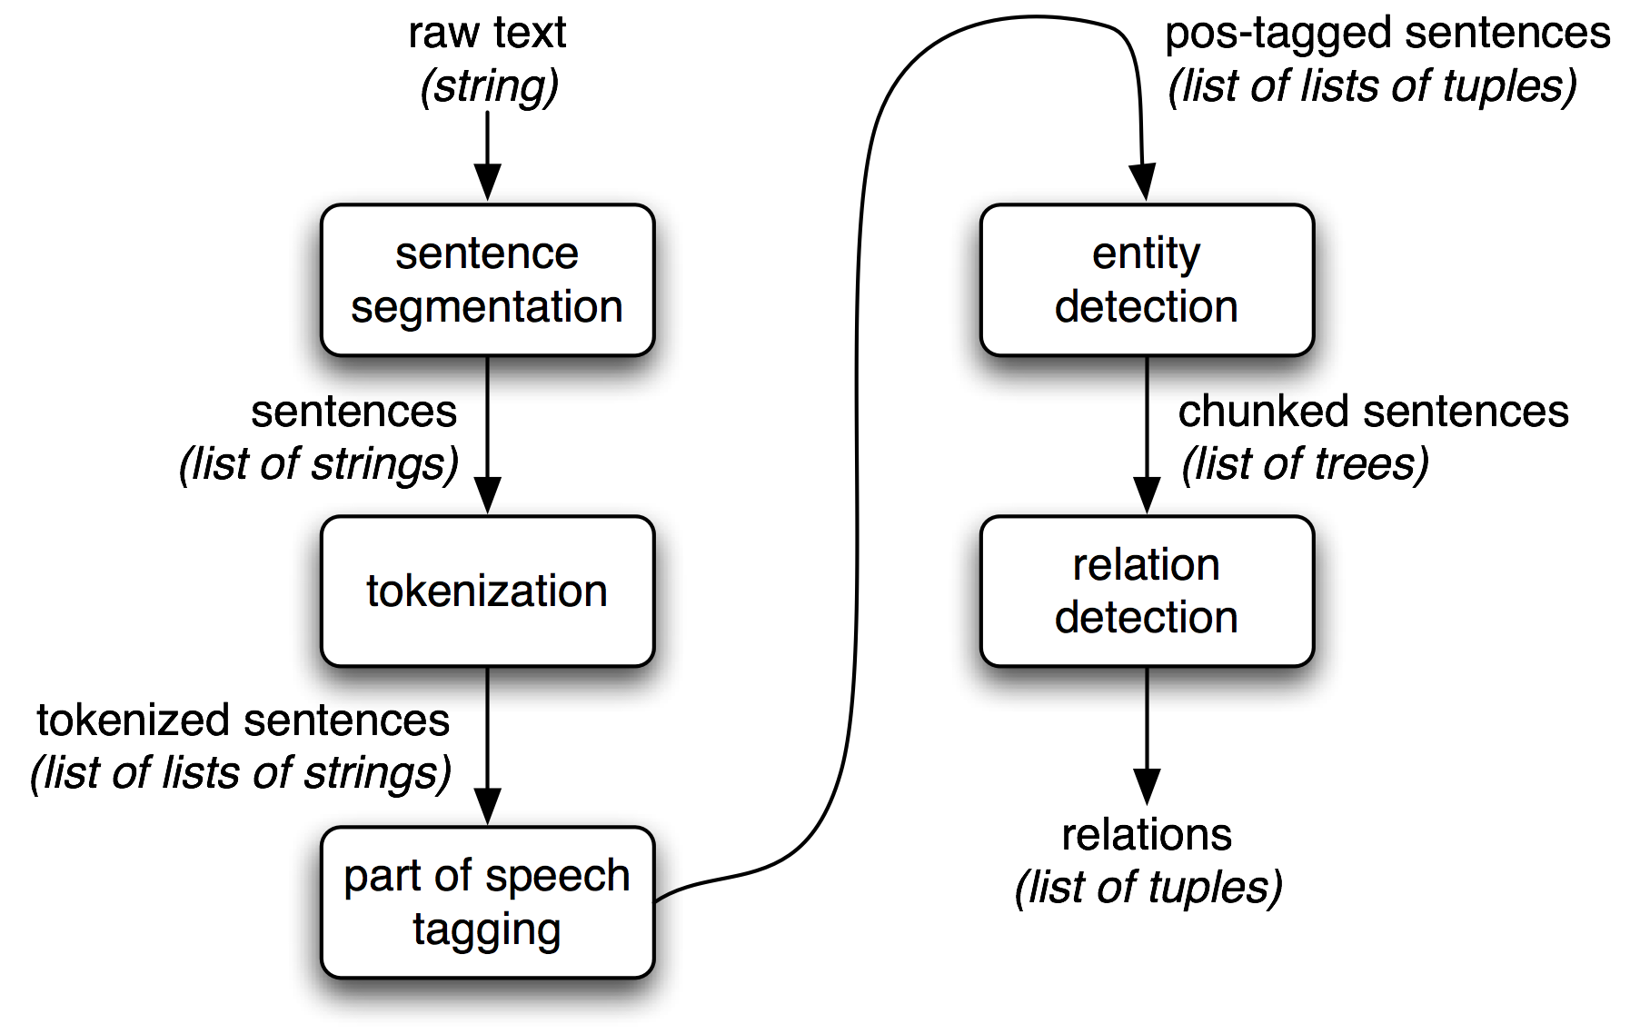
A Standard NLP Pipeline

Slide 10
Tokenization and Sentence Segmentation
Given a document, find the sentence and token boundaries
The police chased Mr. Smith of Pink Forest, Fla. all the way to Bethesda, where he lived. Smith had escaped after a shoot-out at his workplace, Machinery Inc.
Why?
Word counts may be important features
Words may themselves be the object you want to classify
“lived.” and “lived” should give the same information
different analyses need to align if you want to leverage multiple annotators from different sources/tasks

Slide 11
Part of Speech (POS)
Allows simple abstraction for pattern detection
Disambiguate a target, e.g. “make (a cake)” vs. “make (of car)”
Specify more abstract patterns, e.g. Noun Phrase: ( DT JJ* NN )
Specify context in abstract way
e.g. “DT boy VBX” for “actions boys do”
This expression will catch “a boy cried”, “some boy ran”, …
POS | DT | NN | VBD | PP | DT | JJ | NN
Word | The | boy | stood | on | the | burning | deck
POS | DT | NN | VBD | PP | DT | JJ | NN
Word | A | boy | rode | on | a | red | bicycle

Slide 12
Chunking
Identifies phrase-level constituents in sentences
[NP Boris] [ADVP regretfully] [VP told] [NP his wife] [SBAR that] [NP their child] [VP could not attend] [NP night school] [PP without] [NP permission] .
Useful for filtering: identify e.g. only noun phrases, or only verb phrases
Groups modifiers with heads
Useful for e.g. Mention Detection
Used as source of features, e.g. distance (abstracts away determiners, adjectives, for example), sequence,…
More efficient to compute than full syntactic parse
Applications in e.g. Information Extraction – getting (simple) information about concepts of interest from text documents

Slide 13
Named Entity Recognition
Identifies and classifies strings of characters representing proper nouns
[PER Neil A. Armstrong] , the 38-year-old civilian commander, radioed to earth and the mission control room here: “[LOC Houston] , [ORG Tranquility] Base here; the Eagle has landed."
Useful for filtering documents
“I need to find news articles about organizations in which Bill Gates might be involved…”
Disambiguate tokens: “Chicago” (team) vs. “Chicago” (city)
Source of abstract features
E.g. “Verbs that appear with entities that are Organizations”
E.g. “Documents that have a high proportion of Organizations”

Slide 14
Coreference
Identify all phrases that refer to each entity of interest – i.e., group mentions of concepts
[Neil A. Armstrong] , [the 38-year-old civilian commander], radioed to [earth]. [He] said the famous words, “[the Eagle] has landed”."
The Named Entity recognizer only gets us part-way…
…if we ask, “what actions did Neil Armstrong perform?”, we will miss many instances (e.g. “He said…”)
Coreference resolver abstracts over different ways of referring to the same person
Useful in feature extraction, information extraction

Slide 15
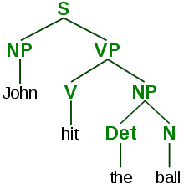
Parsers
Identify the grammatical structure of a sentence
object
subject
modifier
John
hit
the
ball
Dependency parse
Parsers reveal the grammatical relationships between words and phrases
Full parse

